Slide 1
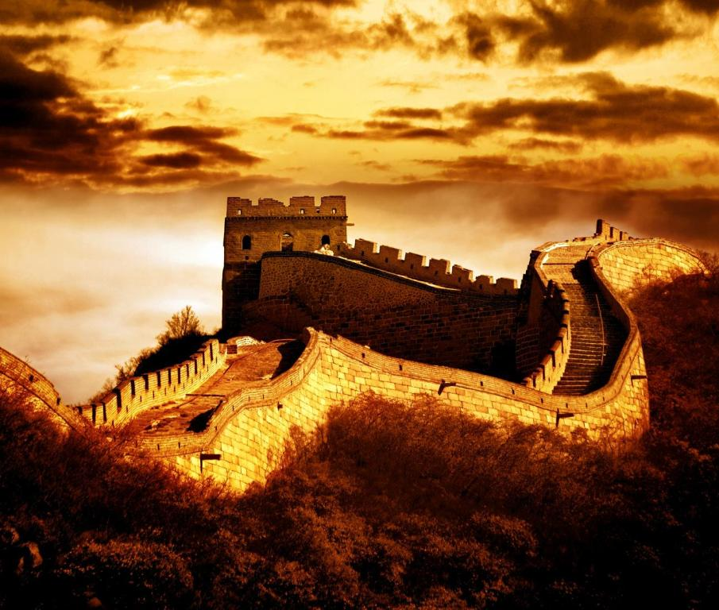
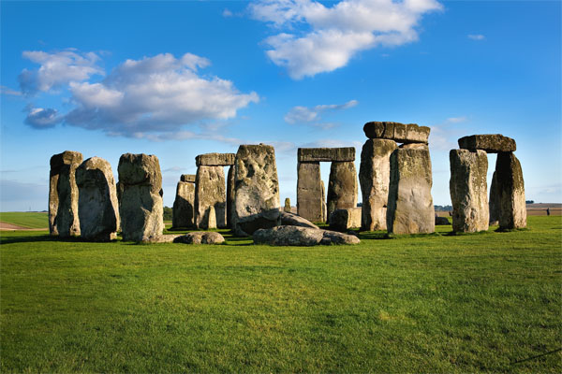
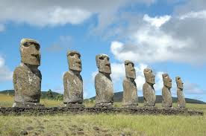
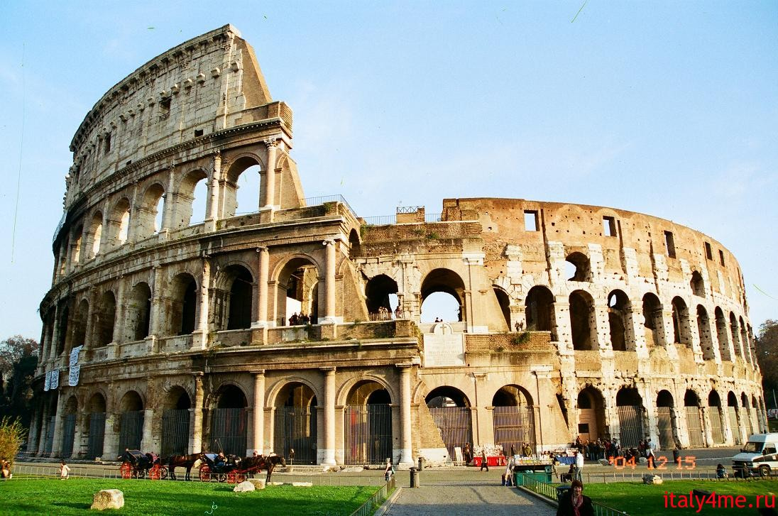

Slide 2
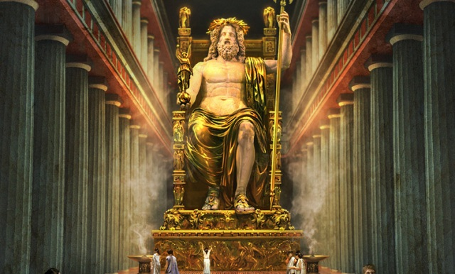
Man - made Wonders.

Slide 3
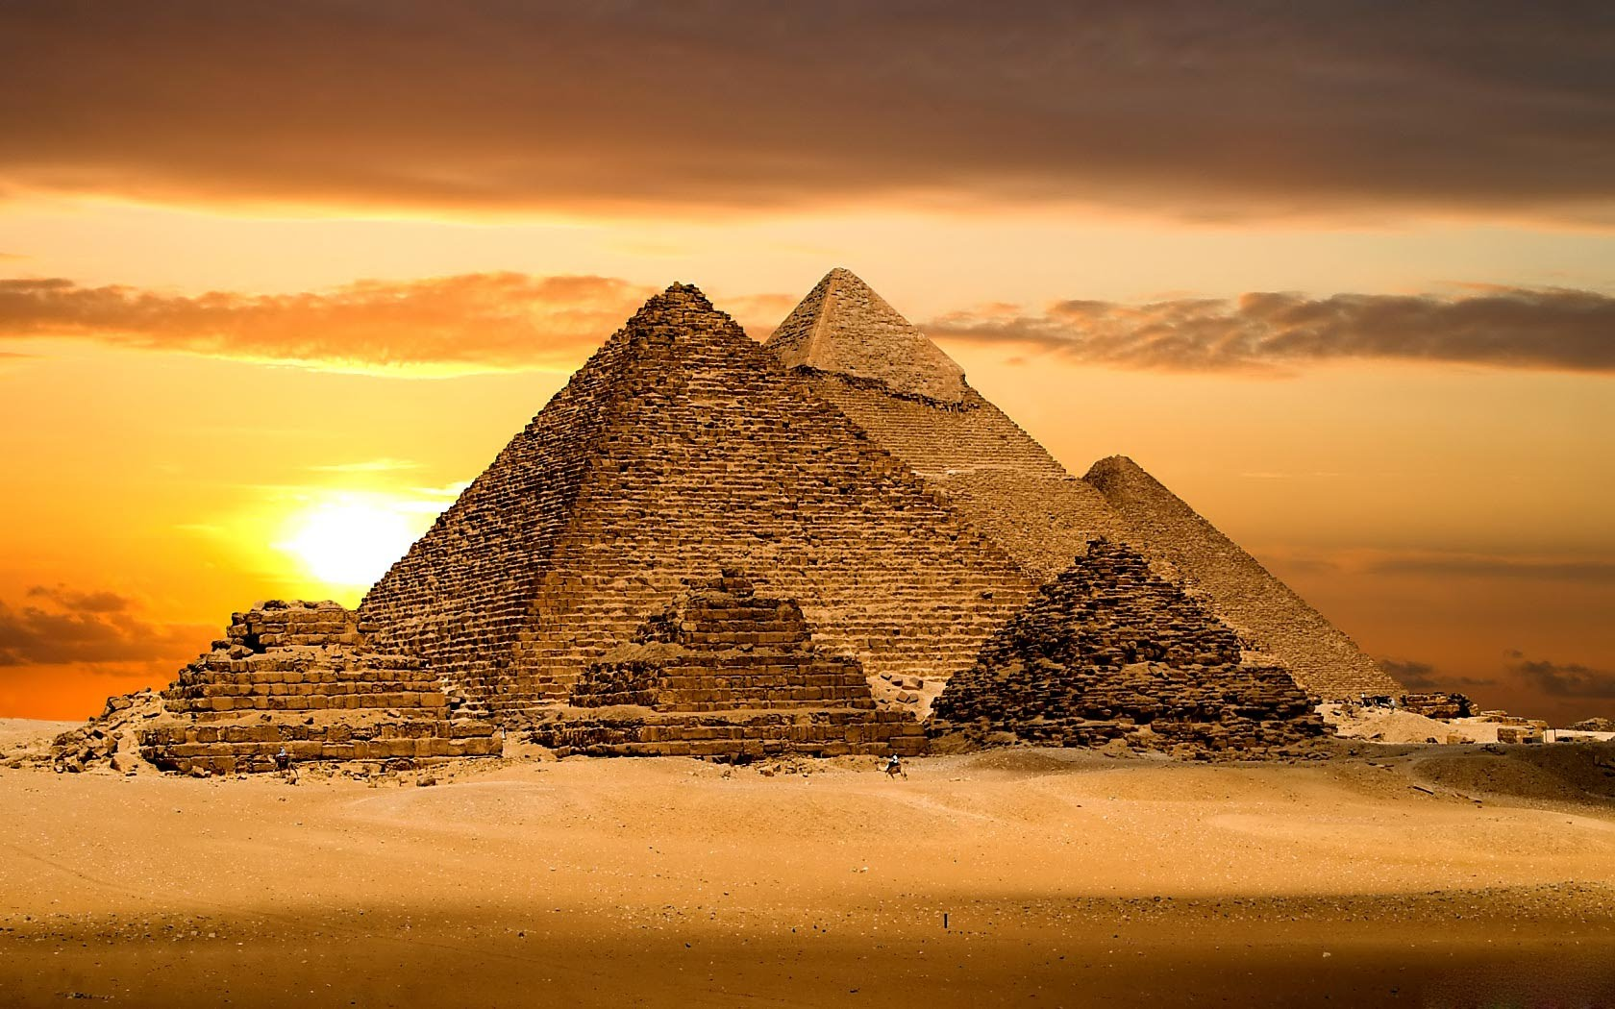

Slide 4
Listening Task
1. What monument does the speaker tell about?
2. How old are the Pyramids?
3. Why did the ancient Egyptians build them?
4. Why do some scientists not believe that the Pyramids are man – made wonder?
5. Do you believe that ancient Egyptians created this monument?

Slide 5
Articles with Geographical names
NO the
countries, cities, continents, streets, squares: Africa, France, Moscow, Green Street, Red Square
mountain picks: Everest
islands in singular form: Java, Cyprus

Slide 6
the
oceans, seas, lakes, rivers: the Black sea, the Pacific ocean But: lake Baikal
mountains : the Urals, the Alps
groups of islands
deserts: the Sahara desert
the UK, the USA, the Russian Federation, the Netherlands, the Caucasus, the Ukraine, the Crimea, the Hague , the Vatican, the Congo, the Transvaal
the North Pole, the South Pole
the East, the West, the North, the South

Slide 7
Thank you for the lesson!

